Slide 1
Event management system Database
Structure, organization and implementation of
Presented by:
Shayan BSE-23F-070
Abu Baker BSE-23F-058
Nimra Babar BSE-23F-128
Date: June 3, 2024

Slide 2

PURPOSE OF THIS DATABASE:
The purpose of the event management system database is to provide a structured and efficient way to manage all aspects of organizing and running events. This includes handling details about the events themselves, managing attendees, scheduling, assigning tasks, securing venues, obtaining and managing sponsorships, and collecting feedback. The goal is to streamline the event management process, ensuring that all information is organized, accessible, and easy to manage.

Slide 3
PROBLEM IT SOLVES
Data Consistency and Integrity: Ensures accurate and consistent data through enforced constraints and validation.
Efficient Attendee Management: Simplifies tracking and managing attendee details, reducing manual errors
Reporting and Analysis: Facilitates easy report generation and data analysis for informed decision-making.
Data Access and Sharing: It allows multiple users to access and share data efficiently and securely.
Keeping Everything in One Place: It puts all event information in one spot, so nothing gets lost and it's easy to find.

Slide 4
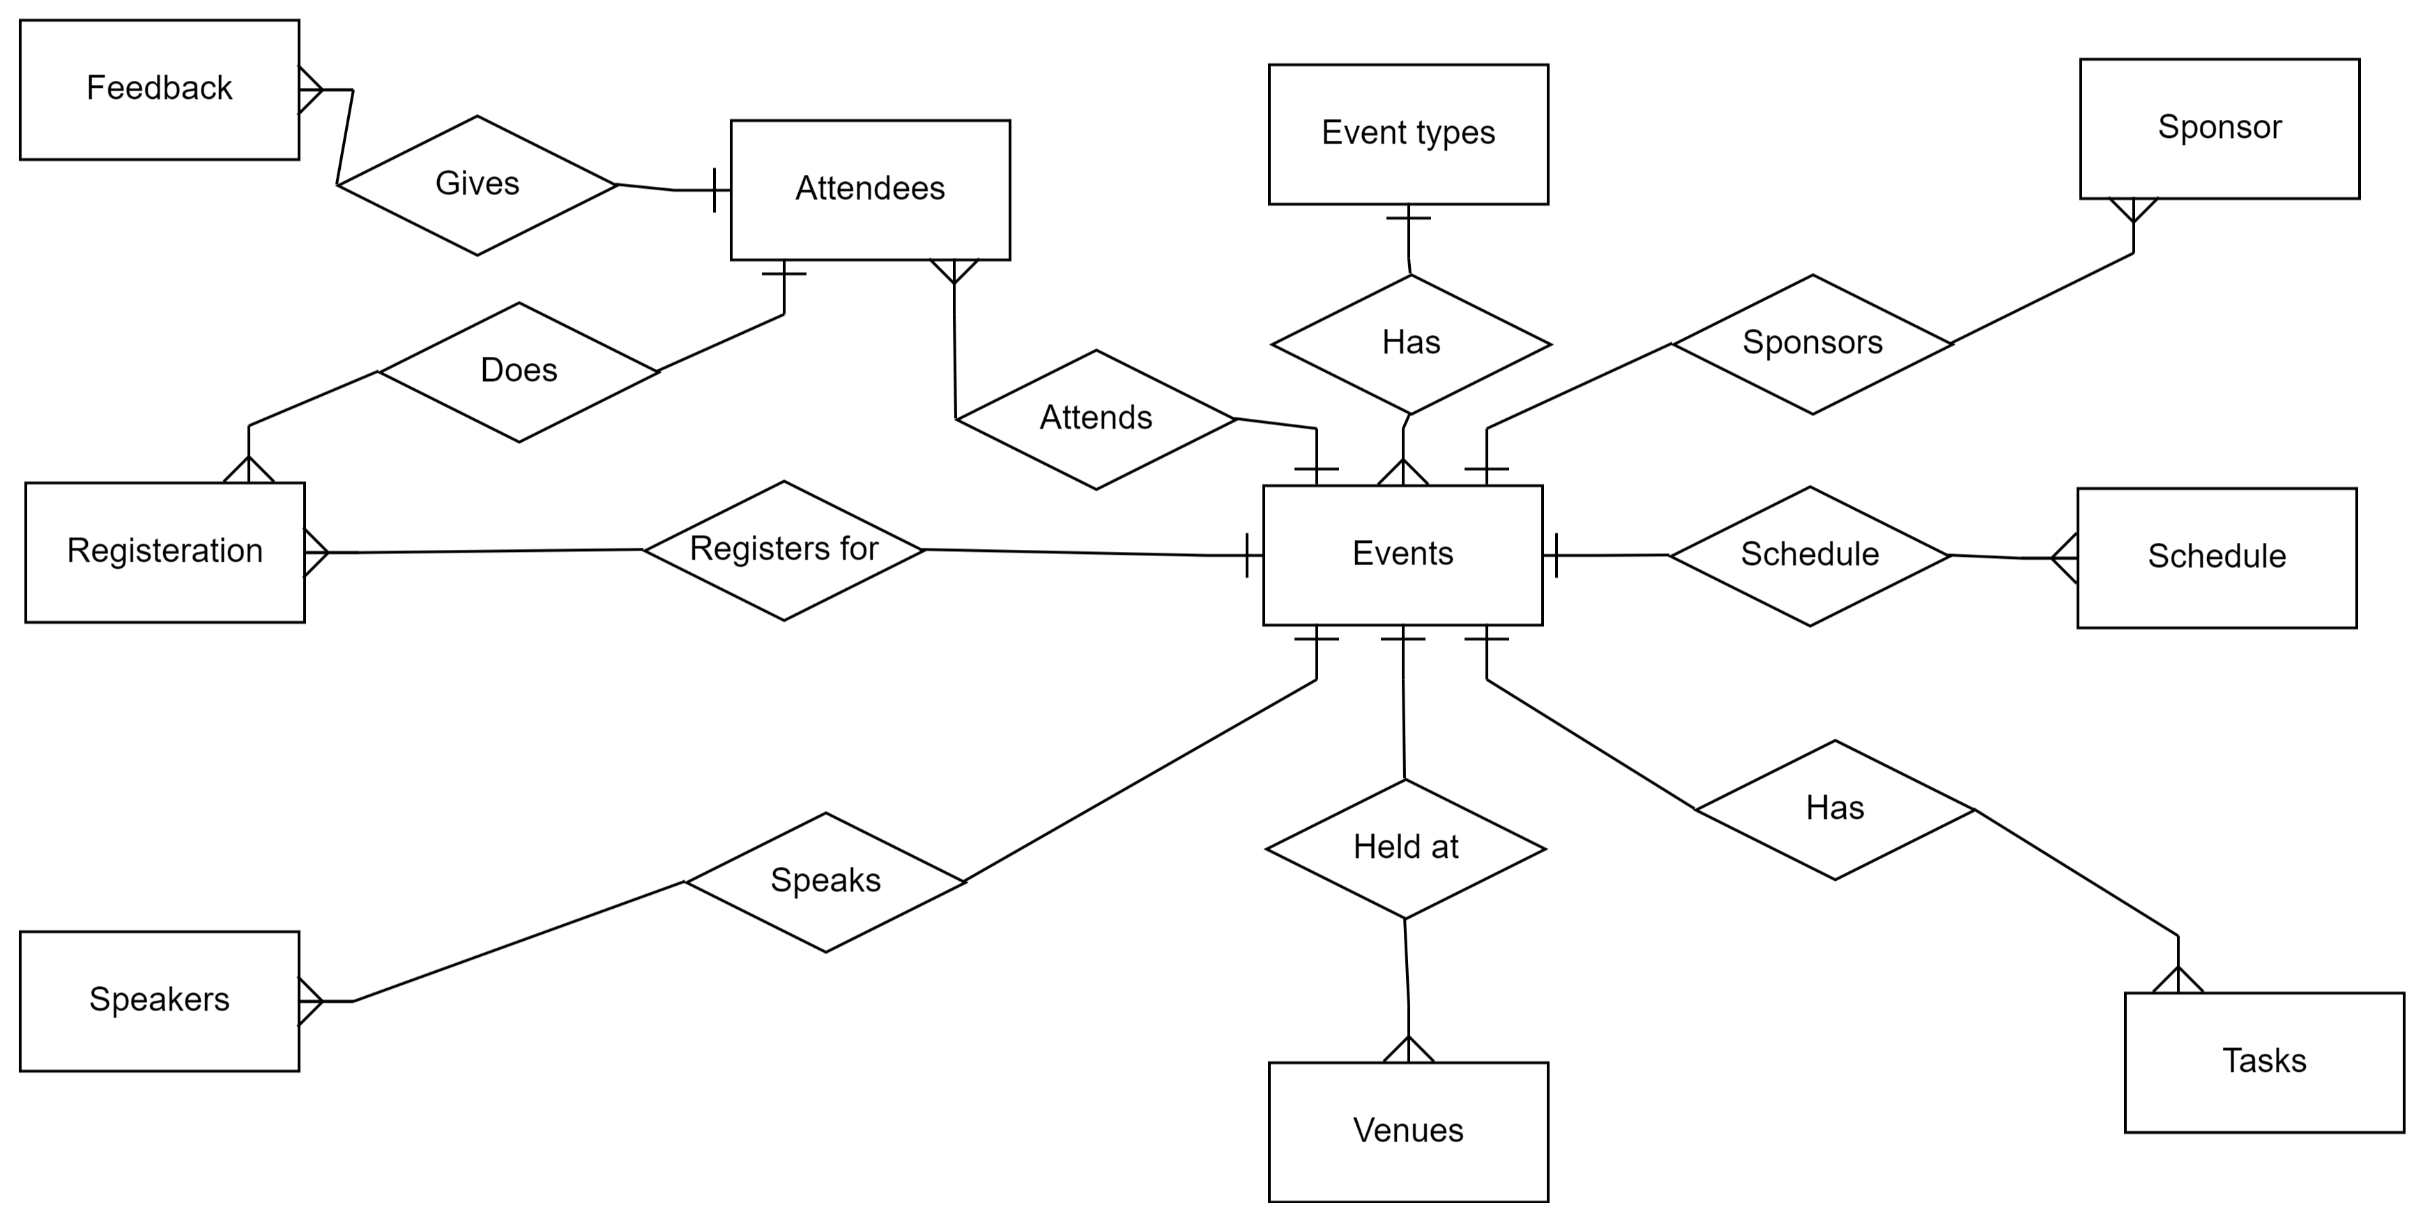
ER Diagram

Slide 5
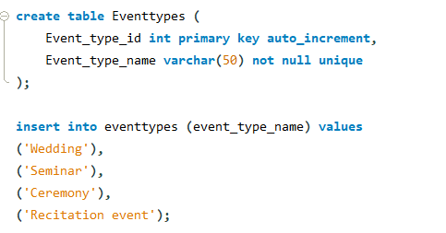

Three picture collage
1.Event types
This table stores different types of events that can occur. It includes an ID for each type and a name for easy identification.

Slide 6
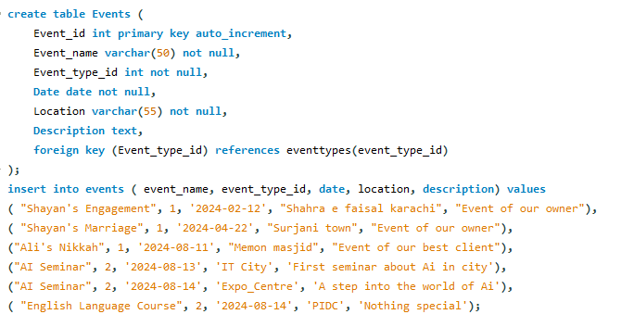
Four picture collage
2.Events
This table holds information about individual events, such as their name, type (referenced from Eventtypes), date, location, and description.

Slide 7
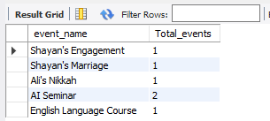
Four picture collage
Queries for these tables:
GROUP BY:
The GROUP BY clause in SQL is used to arrange identical data into groups. It is typically employed with aggregate functions (such as COUNT(), SUM(), AVG(), MAX(), MIN()) to perform calculations on each group of data
Output:

Slide 8

Four picture collage
HAVING:
The HAVING clause in SQL is used to filter groups of rows based on a specified condition. The HAVING clause is applied after the GROUP BY clause and after the aggregate functions have been calculated.
Output:

Slide 9
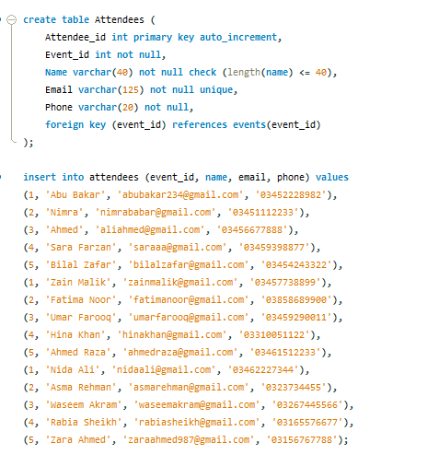
3.Attendees
Stores information about individuals attending events, including their name, email, phone number, and the event they are attending (referenced from Events)

Slide 10
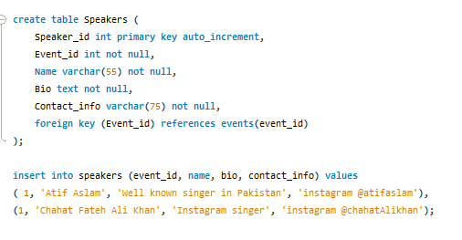
4.Speakers
Contains details about speakers participating in events, such as their name, biography, contact information, and the event they are speaking at (referenced from Events)

Slide 11
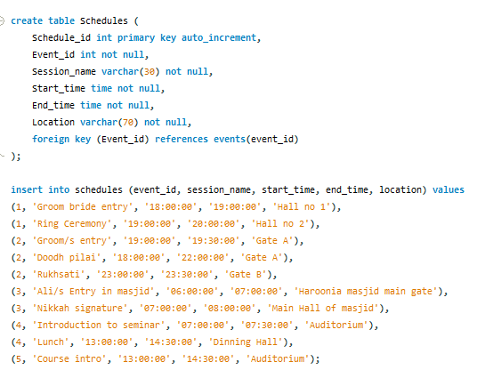
5.Schedules
This table manages the schedules of events, including session names, start and end times, and locations, all associated with a specific event (referenced from Events).

Slide 12
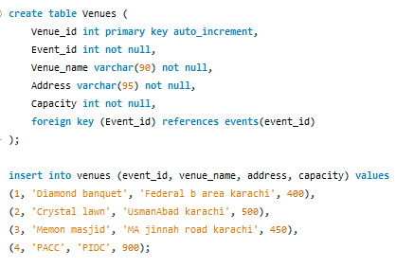
6.Venues
Stores information about event venues, such as their name, address, and capacity, associated with a specific event (referenced from Events)

Slide 13
Queries for these tables:
Distinct:
In MySQL, the DISTINCT keyword is used in a SELECT statement to eliminate duplicate rows from the result set. It ensures that only unique values are returned for the specified columns.
The syntax for using DISTINCT is as follows:
SELECT DISTINCT column1, column2, ...
FROM table_name;

Slide 14
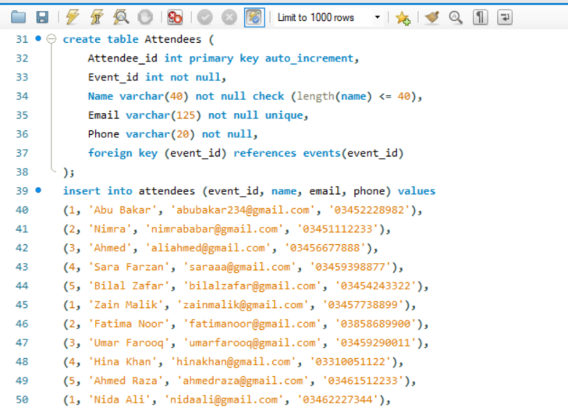
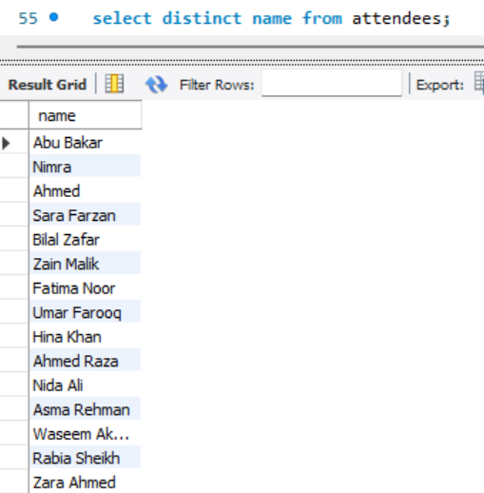
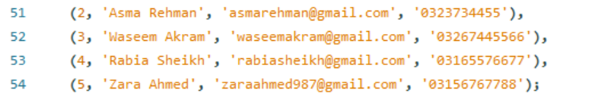

Slide 15
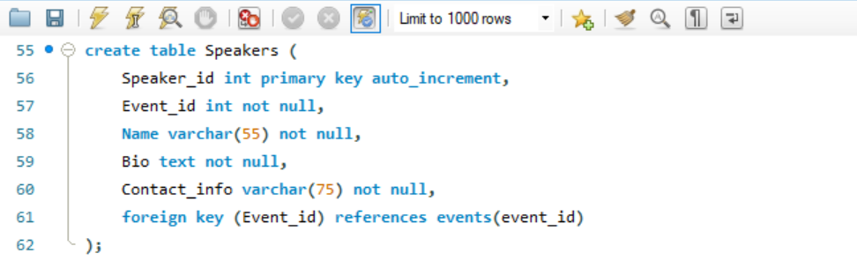
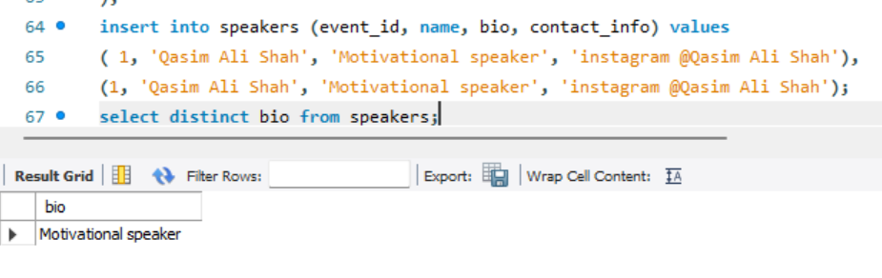

Slide 16
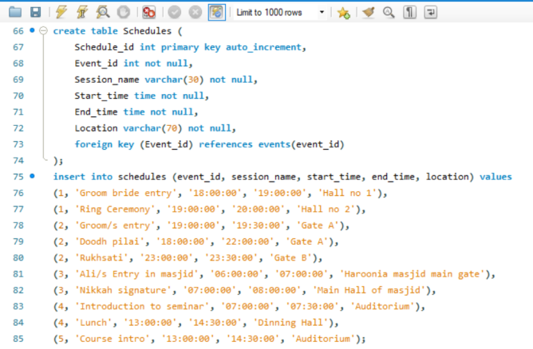
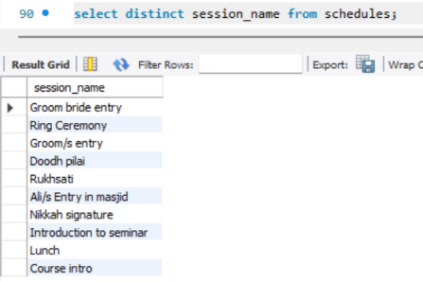

Slide 17
LIKE:
The LIKE operator is used in a WHERE clause to search for a specified pattern in a column.
The percent sign (%) represents zero, one, or multiple characters.
Starts With, Ends With, and Contains:
To find records that start with a specific letter or phrase, add the % at the end of the letter or phrase.
To find records that end with a specific letter or phrase, add the % at the beginning.
To find records that contain a specific letter or phrase, use % both before and after.

Slide 18
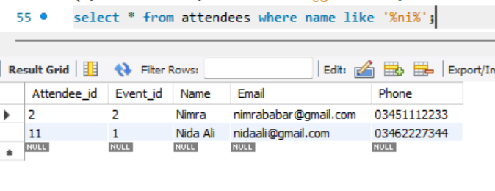

Slide 19
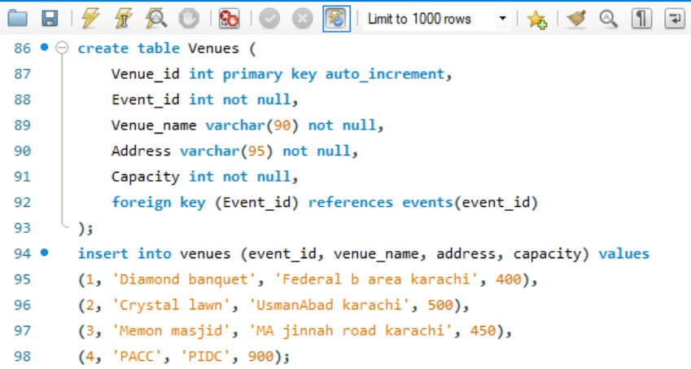
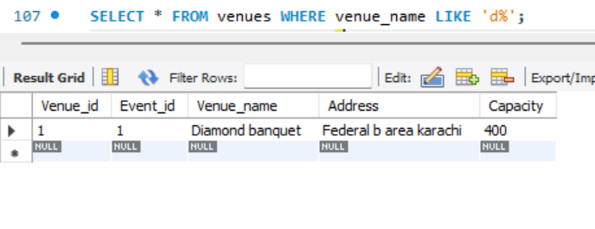
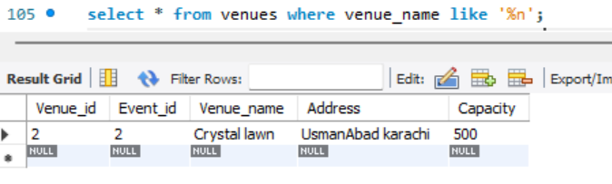

Slide 20
Aggregate functions SUM, MIN, MAX, AVERAGE.
ANS: In MySQL, aggregate functions are used to perform calculations on a set of values and return a single value. Here are some commonly used aggregate functions:
SUM: Calculates the sum of values in a column.
SELECT SUM(column_name)
FROM table_name;

Slide 21
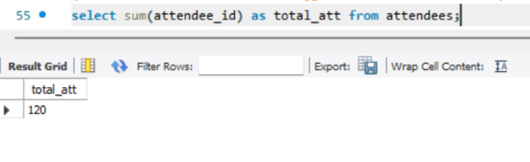

Slide 22
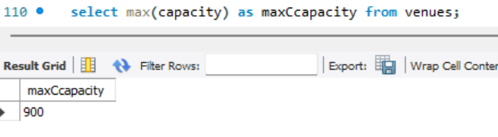
MAX: Finds the maximum value in a column.
SELECT MAX(column_name)
FROM table_name;

Slide 23
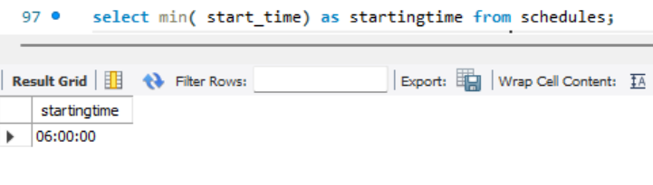
MIN: Finds the minimum value in a column.
SELECT MIN(column_name)
FROM table_name;

Slide 24
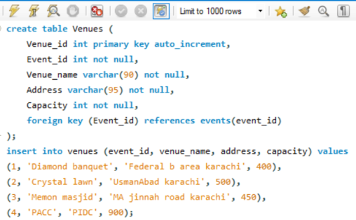
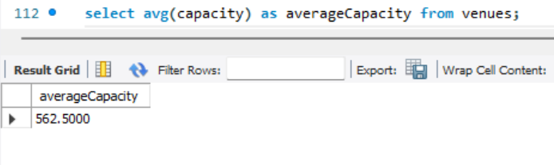
AVG: Calculates the average value of a column.
SELECT AVG(column_name)
FROM table_name;

Slide 25
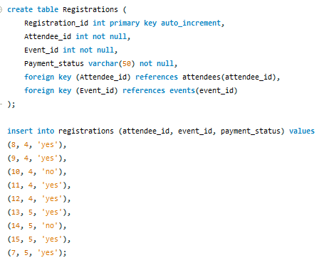
7.Registrations
Keeps track of registrations for events, including attendee and event IDs, along with payment status.

Slide 26
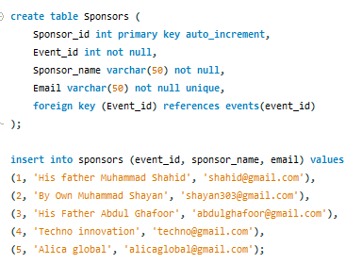
8.Sponsers
Stores details about event sponsors, such as their name and email, associated with a specific event (referenced from Events).

Slide 27
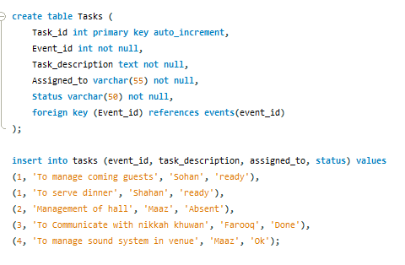
9.Tasks
This table manages tasks related to organizing events, including descriptions, assignments, and status, all associated with a specific event (referenced from Events).

Slide 28
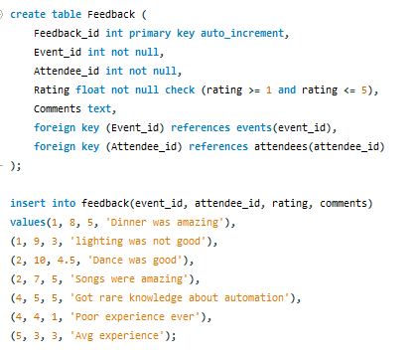
10.Feedback
Stores feedback from attendees about events, including ratings and comments, associated with both the event and the attendee.

Slide 29
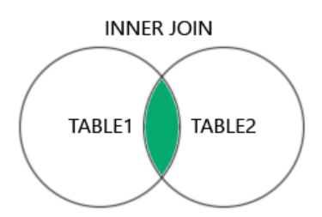
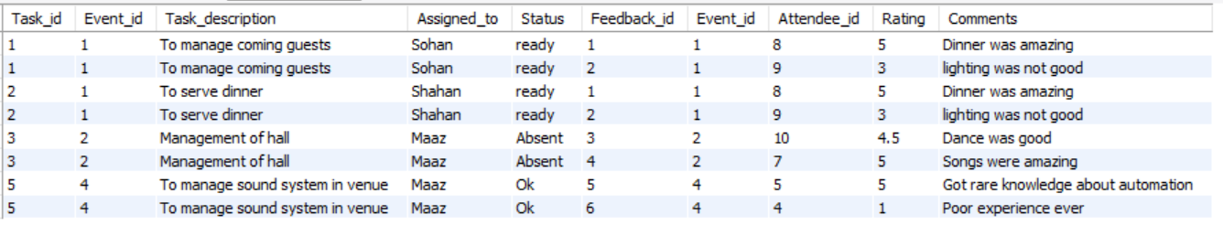
JOINS:
INNER JOIN:
The INNER JOIN keyword selects records that have matching values in both tables.
INNER JOIN Syntax
SELECT column_name(s) FROM table1 INNER JOIN table2 ON table1.column_name = table2.column_name;
QUERY FROM TABLE:
SELECT * FROM Tasks inner JOIN Feedback ON Tasks.Event_id = Feedback.Event_id;

Slide 30
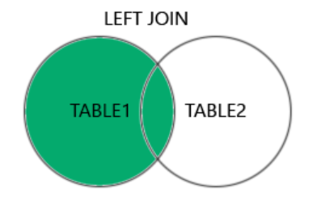
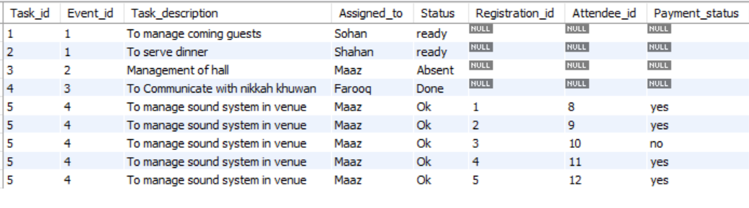
LEFT JOIN:
The LEFT JOIN keyword returns all records from the left table (table1), and the matching records
from the right table (table2). The result is 0 records from the right side, if there is no match.
LEFT JOIN Syntax:
SELECT column_name(s) FROM table1 LEFT JOIN table2 ON table1.column_name = table2.column_name;
QUERY FROM TABLE:
SELECT t.Task_id, t.Event_id, t.Task_description, t.Assigned_to, t.Status, r.Registration_id, r.Attendee_id, r.Payment_status FROM Tasks t LEFT JOIN Registrations r ON t.Event_id = r.Event_id;

Slide 31
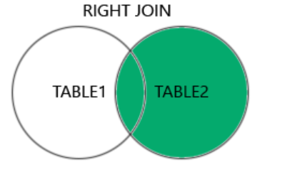
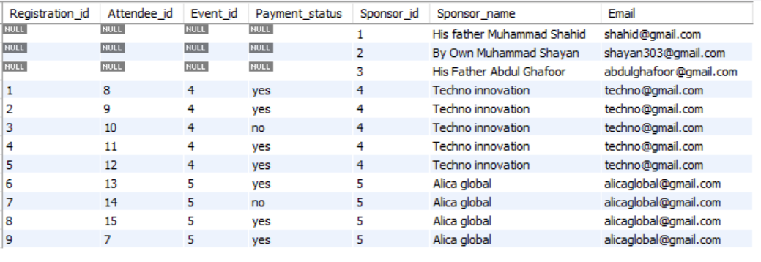
RIGHT JOIN:
The RIGHT JOIN keyword returns all records from the right table (table2), and the matching records from the left table (table1). The result is 0 records from the left side, if there is no match.
RIGHT JOIN Syntax
SELECT column_name(s) FROM table1 RIGHT JOIN table2 ON table1.column_name = table2.column_name;
QUERY FROM TABLE:
SELECT r.Registration_id, r.Attendee_id, r.Event_id, r.Payment_status, s.Sponsor_id, s.Sponsor_name, s.EmailFROM Registrations rRIGHT JOIN Sponsors s ON r.Event_id = s.Event_id;

Slide 32
SELF JOIN:
A SELF JOIN is a regular join, but the table is joined with itself.
SELF JOIN Syntax:
SELECT column_name(s) FROM table1 T1, table1 T2;
QUERY FROM TABLE:
SELECT t1.Task_id, t1.Event_id, t1.Task_description, t1.Assigned_to, t1.Status, t2.Task_id AS Other_Task_id, t2.Task_description AS Other_Task_description, t2.Status AS Other_StatusFROM Tasks t1JOIN Tasks t2 ON t1.Event_id = t2.Event_id AND t1.Task_id != t2.Task_id;

Slide 33
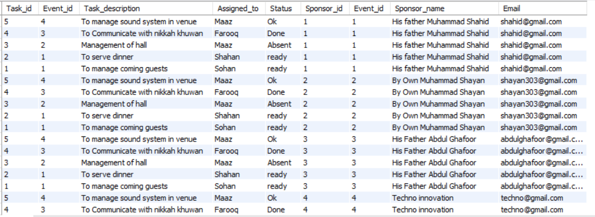
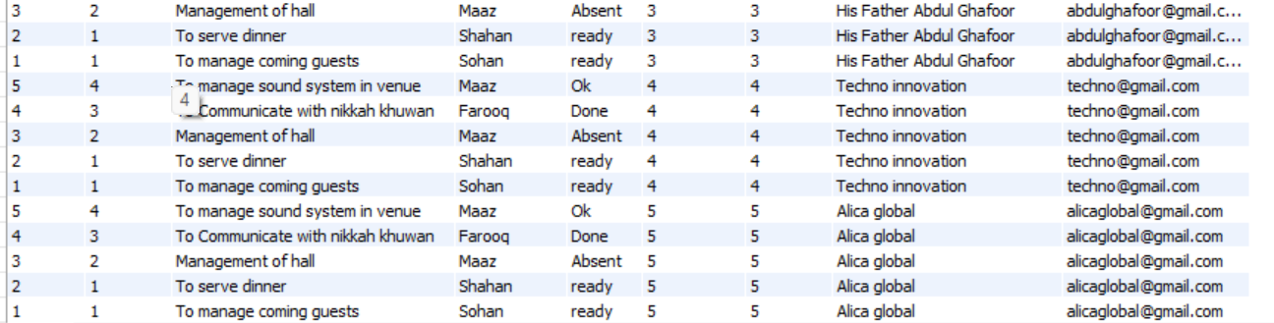
CROSS JOIN:
The CROSS JOIN keyword returns the Cartesian product of the two tables. This means it combines all rows from the first table (table1) with all rows from the second table (table2), resulting in a set of all possible combinations of rows.
CROSS JOIN Syntax:
SELECT column_name(s) FROM table1 CROSS JOIN table2;
QUERY FROM TABLE:
select * from Tasks cross join sponsors;

Slide 34
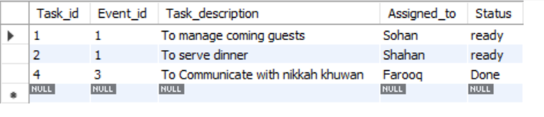
IN:
The IN operator allows you to specify multiple values in a WHERE clause.
The IN operator is a shorthand for multiple OR conditions.
Syntax
SELECT column_name(s) FROM table_name WHERE column_name IN (value1, value2, ...);
QUERY FROM TABLE:
select * from tasks where status in ('ready', 'Done');

